Slide 1
Time Management
“The biggest shortage among
employed people today is time”
– Brian Tracy
Notes:
Slide Show Notes
Today we’re going to talk about time management. We’re going to suggest ways that you can make better use of your valuable time and accomplish more with less effort.
We’ll focus on practical techniques and information that you can start using right away to gain more control over your busy work schedule.
We will cover everything from eliminating time wasters to planning your workday to making time-wise decisions.
The bonus of this training session is that everything you learn today about time management on the job can easily be applied to managing your personal time more efficiently as well.

Slide 2

Take Aways
Notes:
Slide Show Notes
Ask the group what they are wanting to learn from the class, flip chart the responses

Slide 3

Common Time Wasters
Notes:
Slide Show Notes
Let’s begin by identifying some common time wasters. See if you recognize any of these.
Many people waste a lot of time reacting to what’s going on around them instead of determining how their time should be spent. They bounce from one task to another without making much headway on anything.
Some people fail to put in enough time upfront planning their work—determining priorities, deciding how things will be done, anticipating problems, and so forth. But if you don’t plan effectively, you can’t work efficiently.
Too often people don’t take enough time to prepare for a job. Instead of gathering all the equipment, materials, and information they need before they start, they jump right in and later waste time running around looking for the things they need to complete the job.
For many people, the real king of time wasters is procrastination. They keep putting things off, wasting valuable time and creating a situation in which they will later be pressed to get the job done without enough time to do it well or face the prospect of missing a deadline.

Slide 4
Why Work Doesn’t Happen at Work
Jason Fried has a radical theory of working: that the office isn't a good place to do it. In his talk, he lays out the main problems (call them the M&Ms) and offers three suggestions to make work work.
http://www.ted.com/talks/jason_fried_why_work_doesn_t_happen_at_work.html
Notes:
Slide Show Notes
He's the co-founder of 37signals, makers of Basecamp and other web-based collaboration tools, and co-author of "Rework."

Slide 5
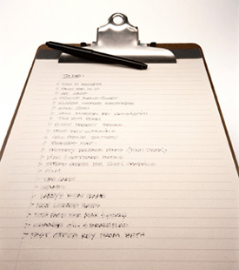
Plan Your Time
Make a daily list
Make a weekly list
Make a monthly list
Notes:
Slide Show Notes
Minimizing time wasters and gaining control over your time begins with effective planning. The minutes or hours you spend planning before you act can turn into days or weeks of time saved.
The first step in planning is to take a few minutes each morning to make a list of all the tasks you have to accomplish that day. Some people like to draw up this list the night before so that they can jump right into things in the morning.
At the beginning of each week, create an expanded list that includes all the essential tasks and activities that must be completed for the week. This list would include timelines for short-term projects, scheduled meetings, deadlines, and so forth.
At the beginning of each month, draw up a master list for that month. Transfer this information to your weekly and daily lists when the time comes. This way, not only will your time be well planned, but you also won’t forget to do any important tasks.
If possible, give each trainee a pocket day planner and a wall calendar for his or her workstation. Tell them they can use these tools to help them keep track of their tasks, deadlines, meetings, and so on.

Slide 6
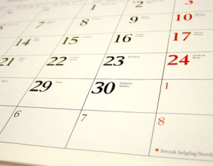
Prioritize Your Tasks
Rank tasks in order of importance
Build in time for the unexpected
Allow time for thinking and planning
Photo by photostock at www.freedigitalphotos.net
Notes:
Slide Show Notes
Organizing your tasks and responsibilities into a prioritized sequence on a daily basis is essential to help you avoid scattering your energies and ending the day with vital tasks left undone.
Each day, rank the tasks and commitments you’ve listed on your calendar in order of importance. You can do this simply by numbering tasks—one being the most important, and so on. But perhaps the most effective method is to assign a priority letter to each task.
“A” stands for must-do tasks with the highest priority.
“B” tasks are important and worthwhile, but if for some reason they cannot be accomplished that day, there will not be a crisis.
“C” tasks can wait until you have the time to do them.
D – delegate
E - eliminate
Build in time for the unexpected—things that may arise and outrank items on your list. Adjust your prioritized list accordingly.
Allow sufficient time in the day for planning, thinking, making decisions, solving problems—things that only you can do. Don’t fill your list with so many high-priority items that you have no time for these important aspects of your job.

Slide 7
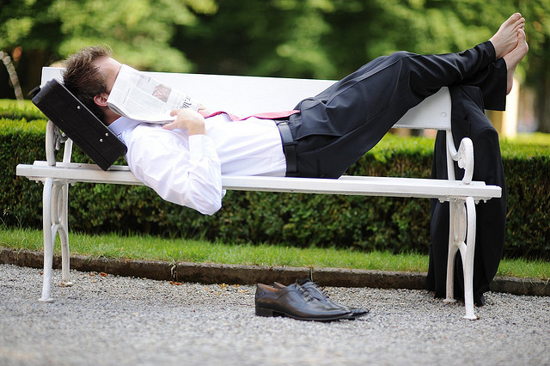
Capitalize on Prime Time
Notes:
Slide Show Notes
The best time managers rely on a little secret that helps them pack extra time into every workday. They capitalize on their prime time. What is prime time?
Your prime time is the time of day when you are at your best—when you’re most alert and energetic. For some people it’s at the beginning of their shift when they are rested and before the day starts to get busy. For others it’s later on when they’ve had a chance to wake up and warm up.
Your prime time may also be the time of day when there are fewest interruptions and you can really concentrate.
It’s important to recognize when your prime time is so that you can take full advantage of it.
Ask trainees to explain when their prime time is and why that particular time allows them to get so much done. If anyone doesn’t know, tell them to pay close attention the next week or so to identify the time of the workday when they have the most energy and get the most done.

Slide 8

Consuming an Elephant
Notes:
Slide Show Notes
It’s easy to become overcommitted. But when you take on too much, you often end up accomplishing very little. If you’re really overwhelmed with work, talk to your supervisor. Maybe you can work something out. Maybe your supervisor can help you readjust your priorities.

Slide 9
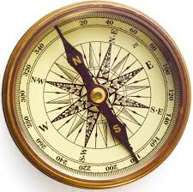
Define Your Goals
Determine the desired end result
Set short-term objectives for reaching goals
Adjust objectives as conditions change
When was the last time you
did something for the
first time?
Notes:
Slide Show Notes
In order to prioritize tasks effectively, you need to have clear goals in mind. A lot of time is wasted when people put effort into activities that don’t directly relate to achieving desired goals.
Defining goals requires first determining the desired end result. What exactly do you need to achieve?
Short-term objectives are the means of achieving goals. They are the steps that must be taken to successfully arrive at a goal. They must be clearly stated and organized in a realistic sequence.
As you work toward your goals, realize that you will need to adjust your objectives as conditions change. If conditions change significantly, you may also need to redefine your goals.

Slide 10
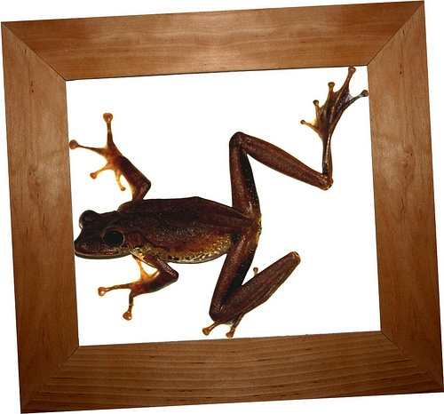
Eat the Ugly Frogs First
Daniela Hartmann
Notes:
Slide Show Notes

Slide 11

Do It Now!
Notes:
Slide Show Notes
Putting things off is a trap we all fall into sometimes. But this just ends up adding more stress to your day. How can you avoid procrastination? There are lots of simple strategies that can help.
Break a job up into smaller parts. This makes the task appear less overwhelming. You don’t have to do the whole job at once; you only need to handle it a piece at a time.
Begin with the easiest parts of the job. This helps get you started. Each little bit you accomplish is a step in the right direction. Accomplishment leads to a feeling of fulfillment, and this gives you the energy and encouragement to persevere.
Once the easy parts are done, it’s time to face the hard or unpleasant tasks squarely. “Just do it!” as the saying goes. Accept the fact that now is as good a time as any to get this part of the job done.

Slide 12

Effective Work Space
Notes:
Slide Show Notes

Slide 13

Avoid Procrastination
Notes:
Slide Show Notes
Schedule yourself. Tell yourself that you’ll work on the task for at least 10 or 15 minutes, and then you can quit. You may well find that you’ll want to go on once you’ve started, but even if you don’t, you’ll feel satisfied about getting a good start.
Reward yourself as you complete each task. For example, if possible, switch to a task you enjoy for a little while. Reward plays a subtle but powerful role in motivating you to persevere and get the job done.
Finally, learn from experience. Why put yourself through the hassles created by procrastinating on the job? Sooner or later, you’re going to have to do the job anyway. So why not do it now and get it over with?
Ask trainees to talk about their own experiences with procrastination. How do they get themselves going and get the job done? Have any of them experienced negative consequences, such as a reprimand or a lost opportunity, as a result of procrastination?

Slide 14
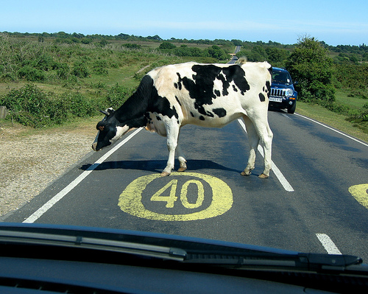
Manage Interruptions
Notes:
Slide Show Notes
Constant interruptions can seriously cut into your schedule and leave you too distracted and frustrated to get your work done.
Whether the interruptions come in the form of unexpected visitors to your workstation or phone calls, set limits for the conversation from the outset. Ask people pleasantly what they want and how much time they’ll need.
Then, lead the conversation directly to the matter at hand. Don’t get involved in small talk.
If possible, answer questions or comply with requests immediately. That way you won’t have to spend time later getting back to the person.
If you’re sitting down, stand up when you are ready to end the conversation. Standing signals the other person that you are preparing to conclude the conversation.
Conclude the conversation firmly. You can indicate the conversation is over by saying something like, “Good, I’m glad that’s settled. Now we can get back to work.”
Ask for two volunteers to role-play a situation in which one of them interrupts the other who is trying to finish an important job. Ask group members to comment on how well the worker handles the interrupter.

Slide 15

Control Communications
Notes:
Slide Show Notes
Controlling your phone and e-mail can also help make better use of your time.
There are two ways to handle incoming calls efficiently. Which you use will depend on your job responsibilities and the directions you’ve been given by your supervisor.
Let voice mail pick up incoming calls, whenever possible. Check at set intervals to make sure you’re not missing important calls. You can return urgent calls right away. The others can wait until you have a break in your schedule.
When you do answer the phone and you are in the middle of something, lead the other person politely but firmly to the point of the call. When you feel the matter is concluded and the person keeps talking, say that you’re sorry but you’re busy and have to go.
When you’re making calls, pick the time that the person you’re calling is most likely to be in so that you won’t have to waste time calling later. Jot down the key points you want to discuss beforehand so that you can get right to the point. If the person you need to speak to isn’t available, leave a message indicating the best time to reach you. This way you can pick a time when the call won’t be an interruption in your schedule.
E-mail and instant messaging are efficient ways to communicate because you don’t have to be there to receive the message, incoming messages don’t disturb you when you are there, and you can respond when you have time.

Slide 16
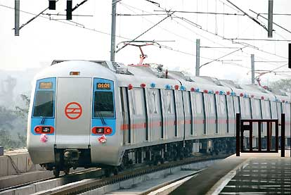
Use Commuting Time Wisely
Plan
Review
Notes:
Slide Show Notes
Many of us spend hours commuting every day. Instead of wasting all that time, use it wisely.
For example, use it to plan the upcoming day or the next day and decide what you need to accomplish.
Or use the time constructively to review work issues, make decisions, or solve problems.
Ask each trainee how long his or her daily round-trip commute takes and how he or she uses the time. Could they take better advantage of this valuable time?

Slide 17
Handle Emergencies
Don’t drop everything
Spend only as much time as necessary
Return to your established schedule
Think about why the emergency occurred
Notes:
Slide Show Notes
Don’t let unexpected events throw a monkey wrench into your whole day.
Except for the most dire emergencies, most unexpected problems can wait a little while. Resist the temptation to drop everything and run to put out a fire. Finish what you’re doing first, give yourself time to think about an appropriate response, and take action to handle the problem.
Spend only as much time as necessary on emergencies. Once the situation is under control, move on.
Return to your established schedule and pick up right where you left off.
Take a moment to think about why the emergency occurred and if there is anything you can do to make sure such things don’t happen again. Anticipating problems is a key time management skill.

Slide 18

Benefits of Managing Time
More productivity
Fewer mistakes
Less stress
More time to do a good job
More success
Notes:
Slide Show Notes
We are conducting this class because we want you to be able to manage your time well so that you can enjoy these benefits:
More productivity
Fewer mistakes
Less stress
More time to do a good job
More success
Ask trainees for examples of situations in which good time management helped them do a difficult job better. Also ask for examples of situations in which they lost control of their time. What were the consequences?

